Slide 1

forester: an R package for automated building of tree-based machine learning models
Adrianna Grudzień, Hubert Ruczyński, Patryk Słowakiewicz
Thesis supervisor: mgr Anna Kozak

Slide 2
Agenda
01
What is forester?
02
AutoML pipeline
03
forester pipeline
07
Market analysis
04
Tree-based models
Why tree-based models?
05
Package structure
A short introduction to the package.
How the user interface look like?
06
Features
How ML pipeline looks and what AutoML is for?
What makes the forester special?
How forester pipeline looks like in detail?
For whom is it created? Why is it better than other tools?

Slide 3
01
What is forester?
A short introduction to the package.

Slide 4
What is the forester?
The forester is an AutoML tool in R for tabular data regression and binary classification tasks, that wraps up all machine learning processes into a single train()function, which includes:
1. rendering a brief data check report,
2. preprocessing the initial dataset enough for models to be trained,
3. training 5 tree-based models with default parameters, random search and Bayesian optimization,
4. evaluating them and providing a ranked list.
However, that’s not everything that the forester has to offer. Via additional functions, the user can easily explain created models with the usage of DALEX or generate one of the predefined reports including:
1. information about the dataset, 2. in-depth parameters of trained models, 3. visualizations comparing the best models, 4. explanations of the aforementioned models.

Slide 5
02
AutoML pipeline
How does the ML pipeline look
and what AutoML is for?
Notes:
Techniczno – teoretyczna część

Slide 6
ML pipeline

Slide 7
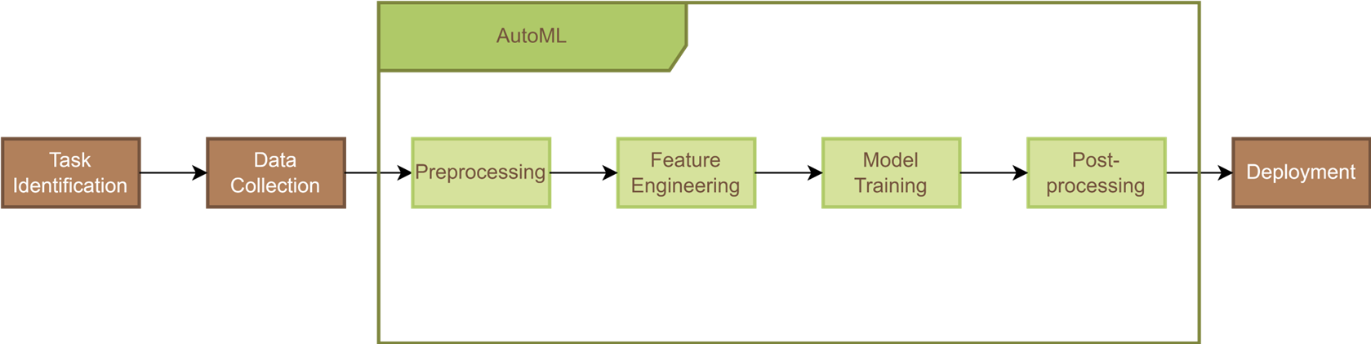
AutoML pipeline

Slide 8
03
forester pipeline
How forester pipeline looks like in detail?

Slide 9
forester pipeline

Slide 10
04
Tree-based models
Why tree-based models?

Slide 11
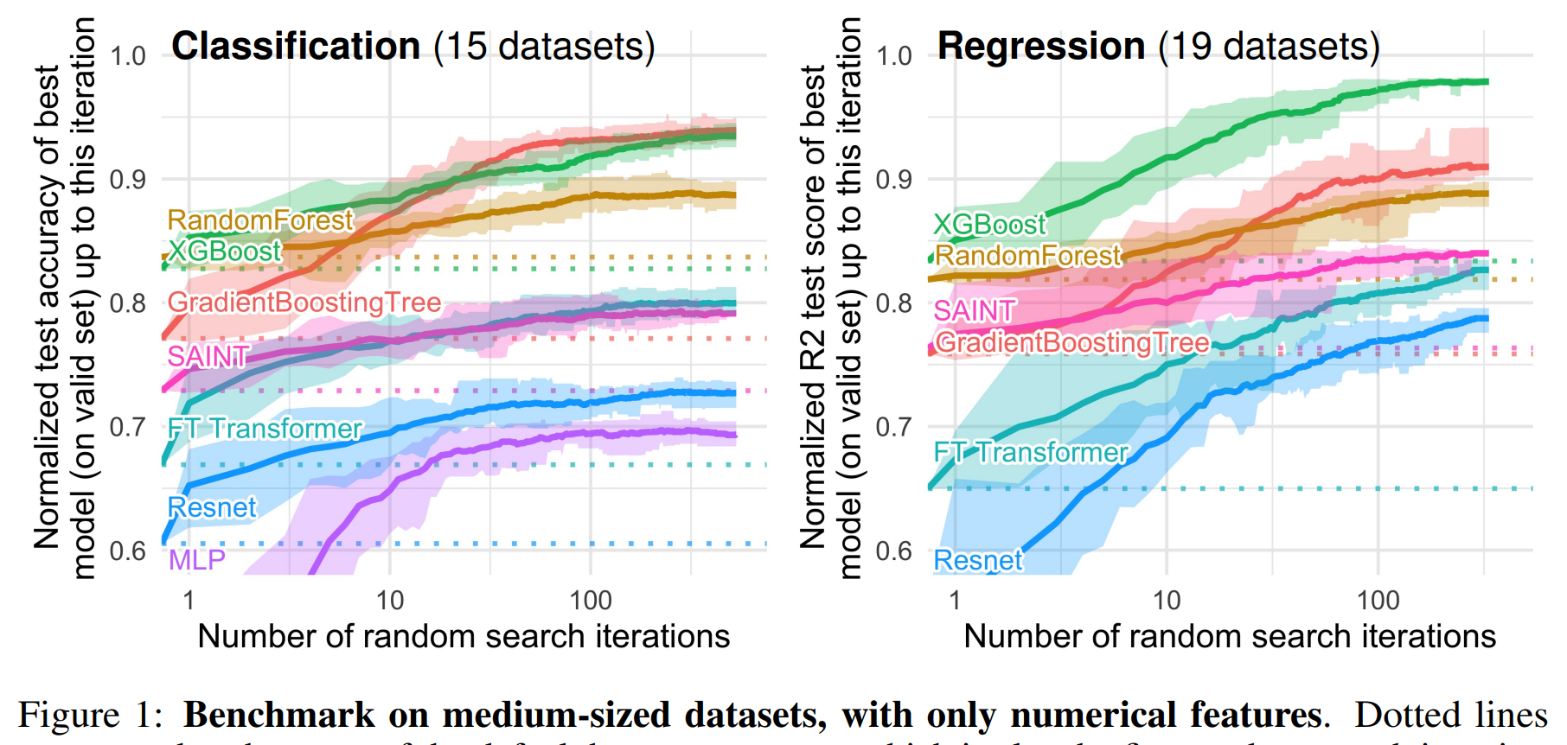
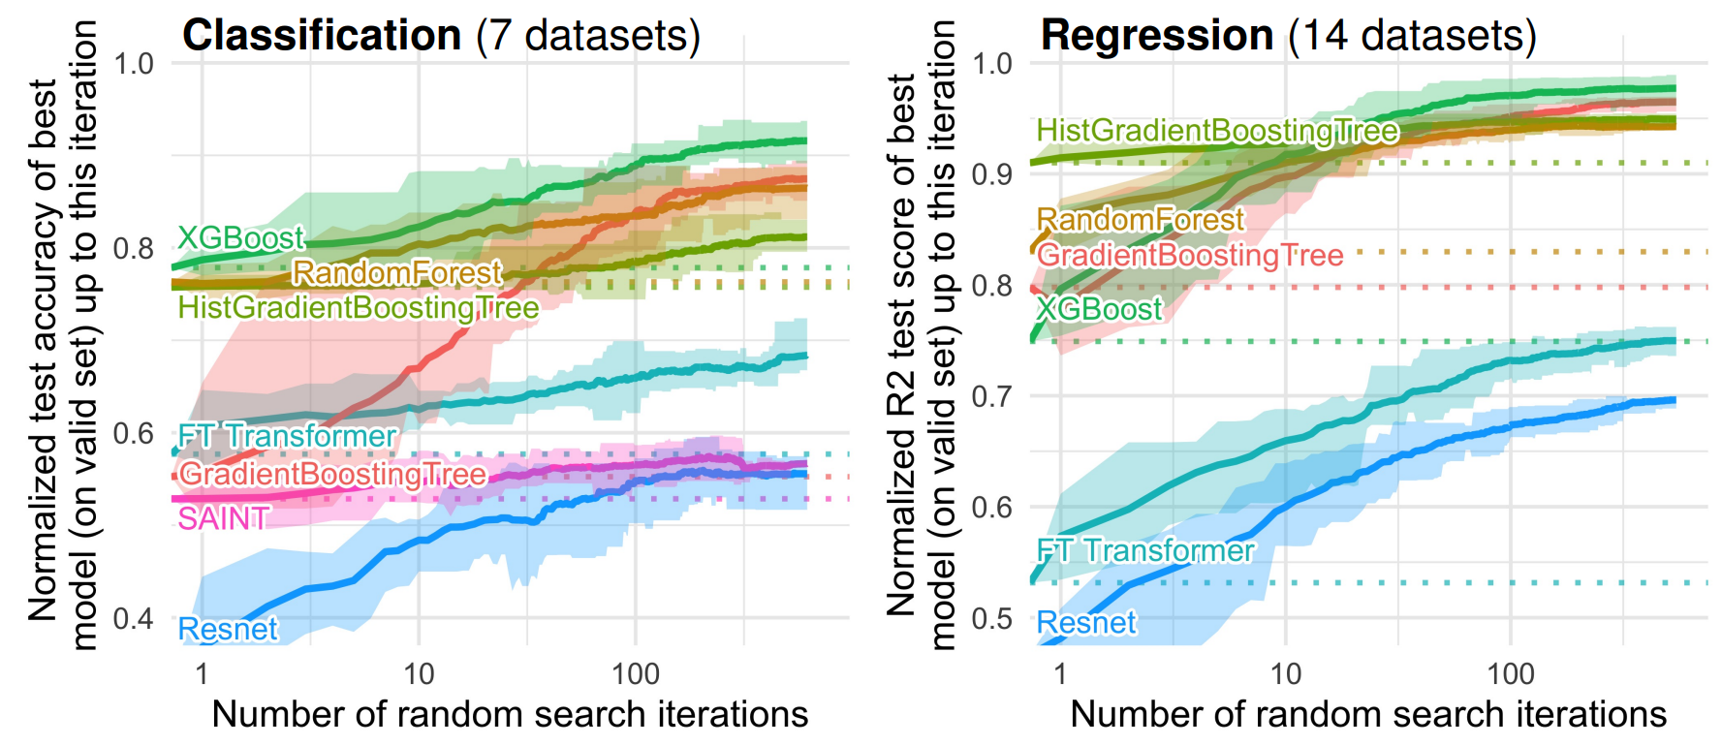
Why tree-based models?
Extremely popular amongst winners in Kaggle competitions, which shows their versatility.
Superior to deep learning neural networks, due to lack of bias towards overly smoothed solutions.
With bagging and boosting ensembles they address their main drawback, which is overfitting.
Tree-based models are easy to understand for users without a ML background and have already established good opinions amongst doctors.
L. Grinsztajn, E. Oyallon, and G. Varoquaux, Why do tree-based models still outperform deep learning on typical tabular data?, NeurIPS 2022 Track Datasets and Benchmarks Program Chairs

Slide 12
05
Package structure
How the user interface look like?

Slide 13
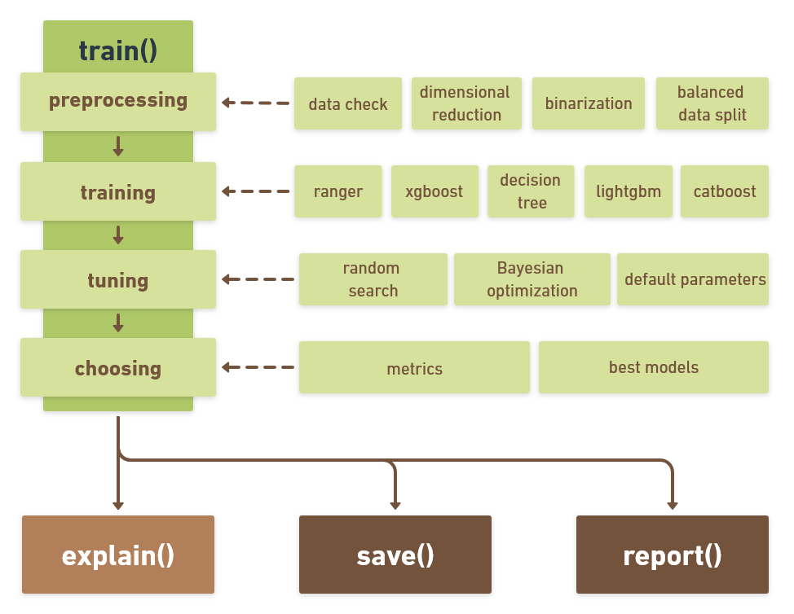
Package structure
With functions in forester package users can create a well-tuned tree-based model with a unified, simple formula. With the usage of only two required parameters: the raw, not preprocessed dataset and target column name, the user is able to achieve satisfying results. The forester automatically handles the "ugly" part for you.

Slide 14
06
Features
What makes the forester special?

Slide 15
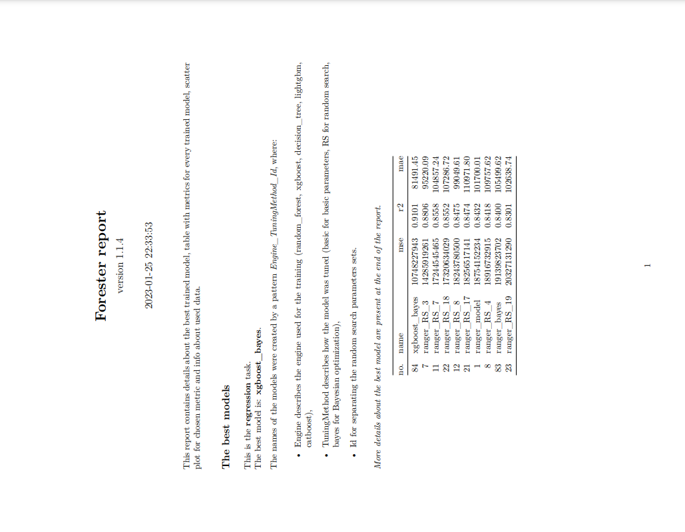
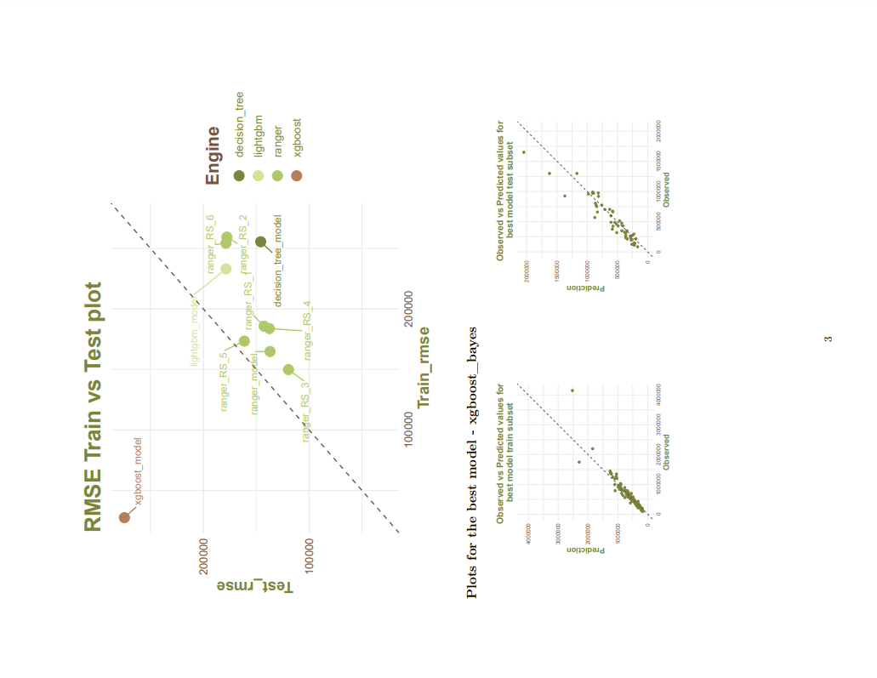
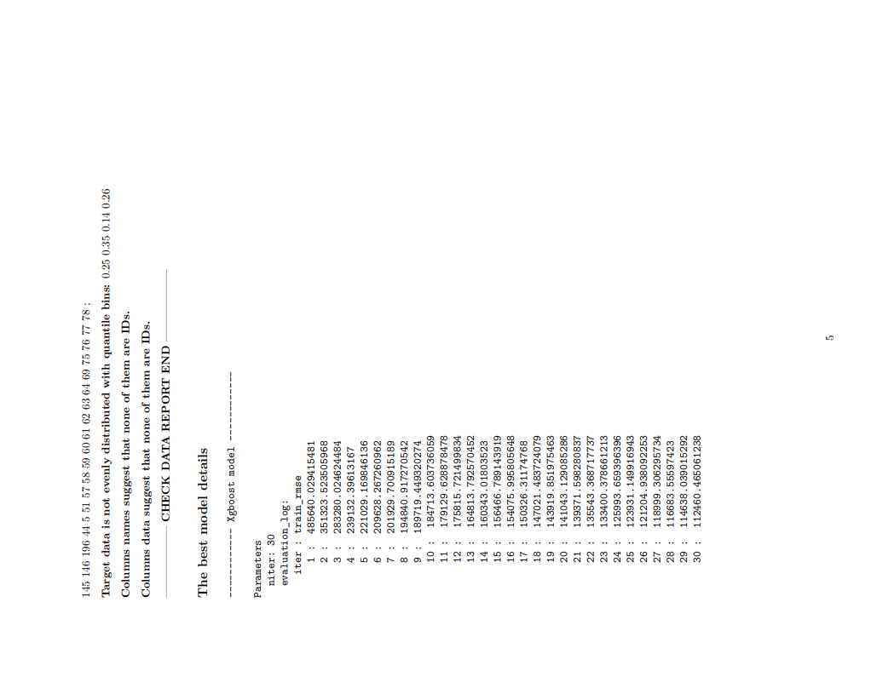
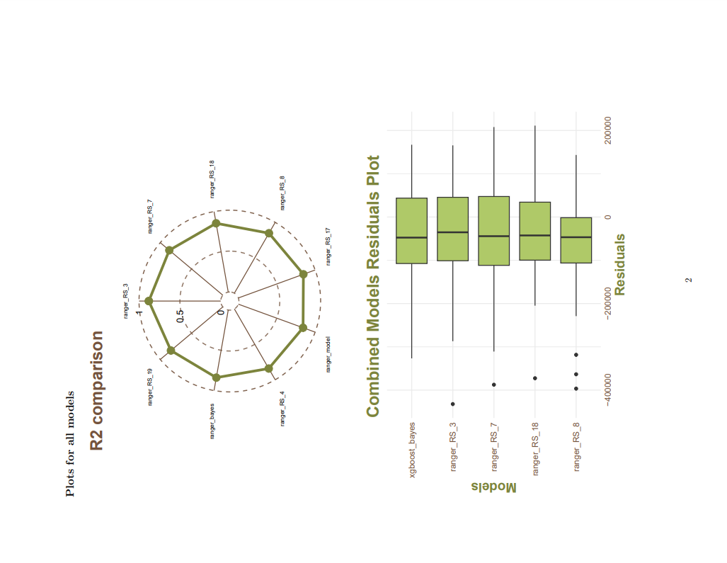
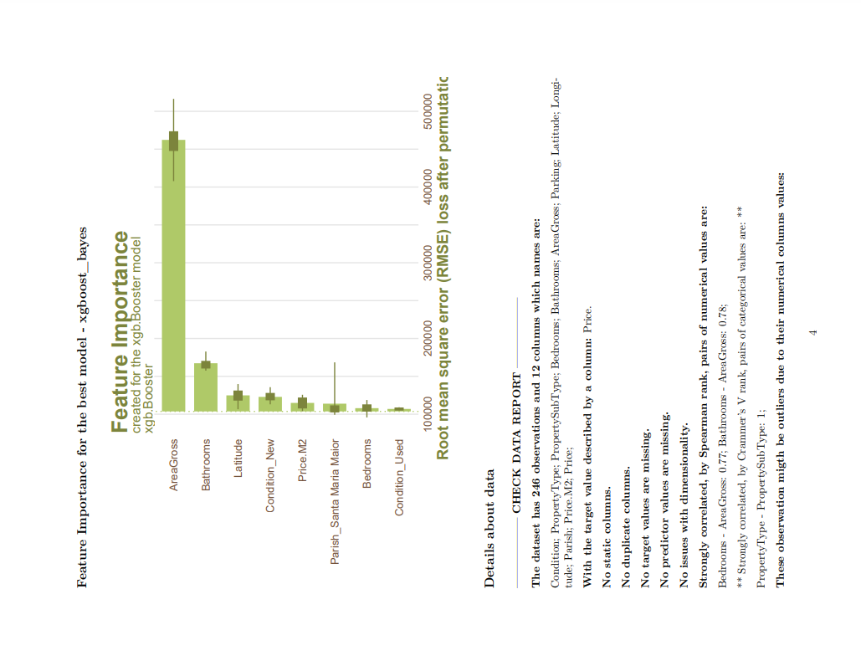
Automatic report for regression task

Slide 16
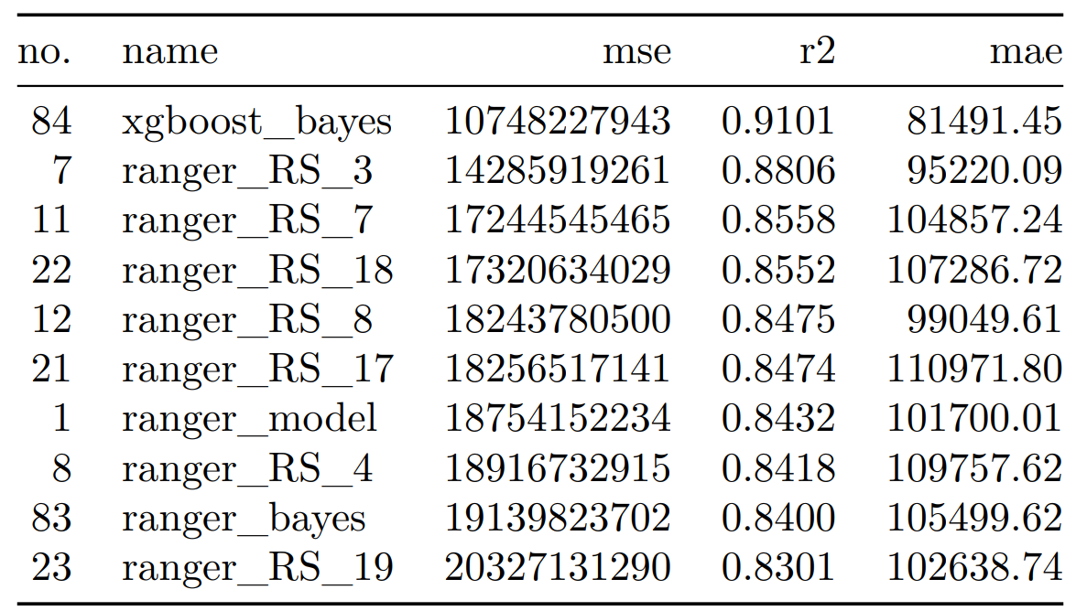
Ranked list
Information about the task and best model.
Intuitive and simple model comparison.
Plenty of metrics, giving good model understanding.

Slide 17
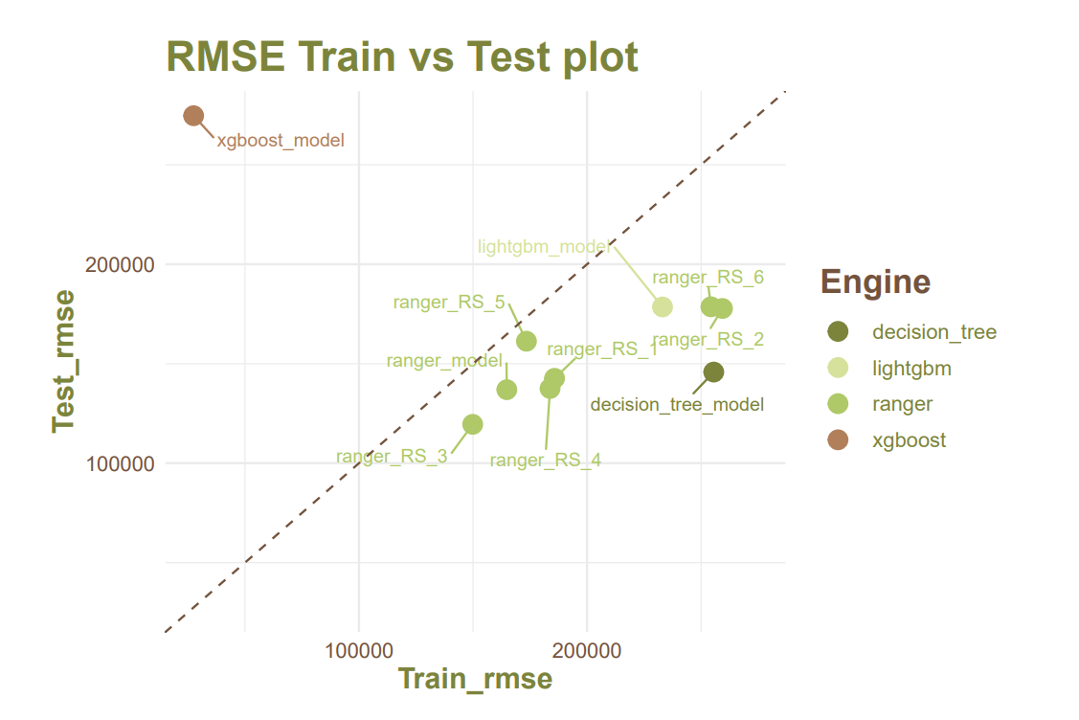
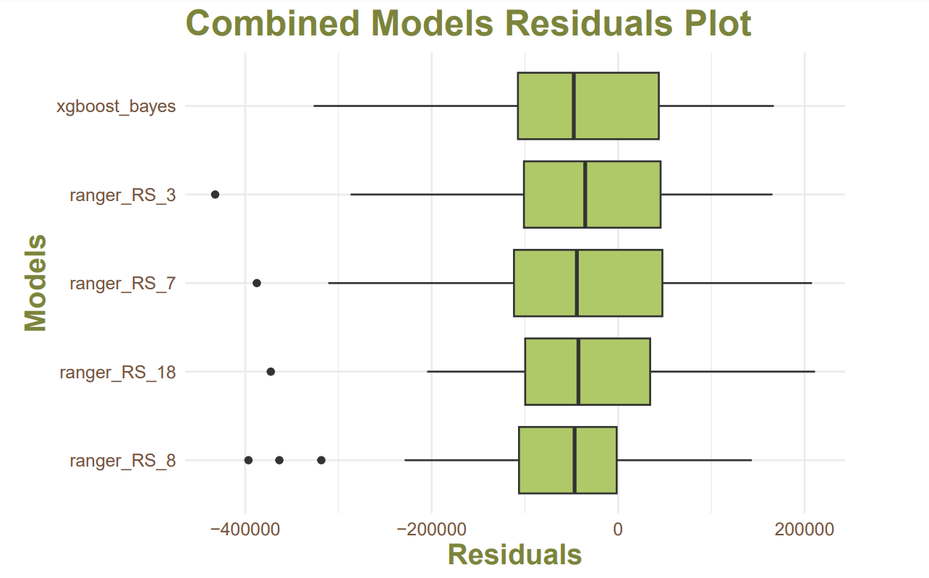
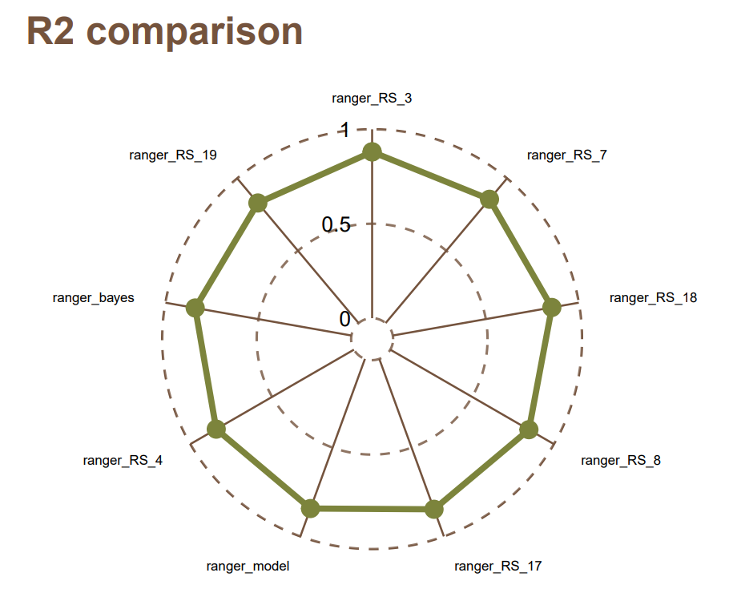
Model comparison plots

Slide 18
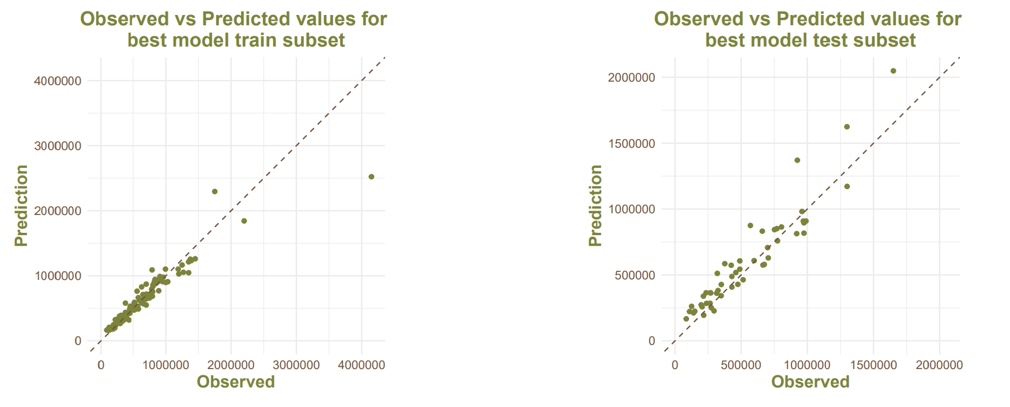
Best model plots

Slide 19
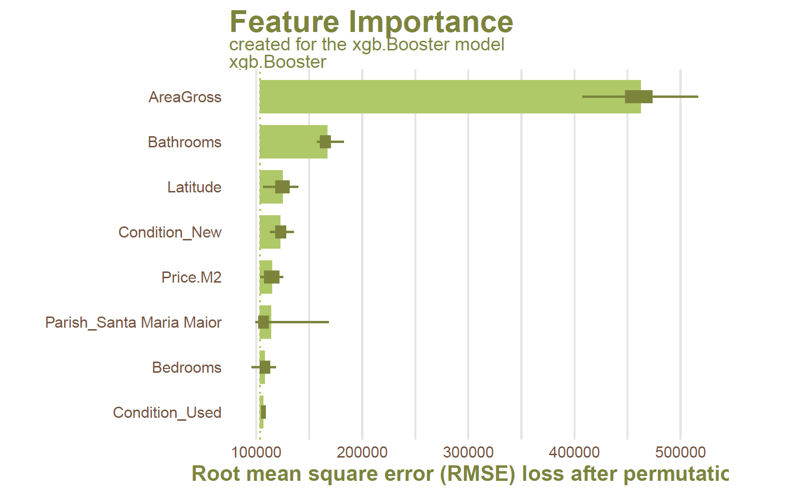
XAI: Feature Importance

Slide 20
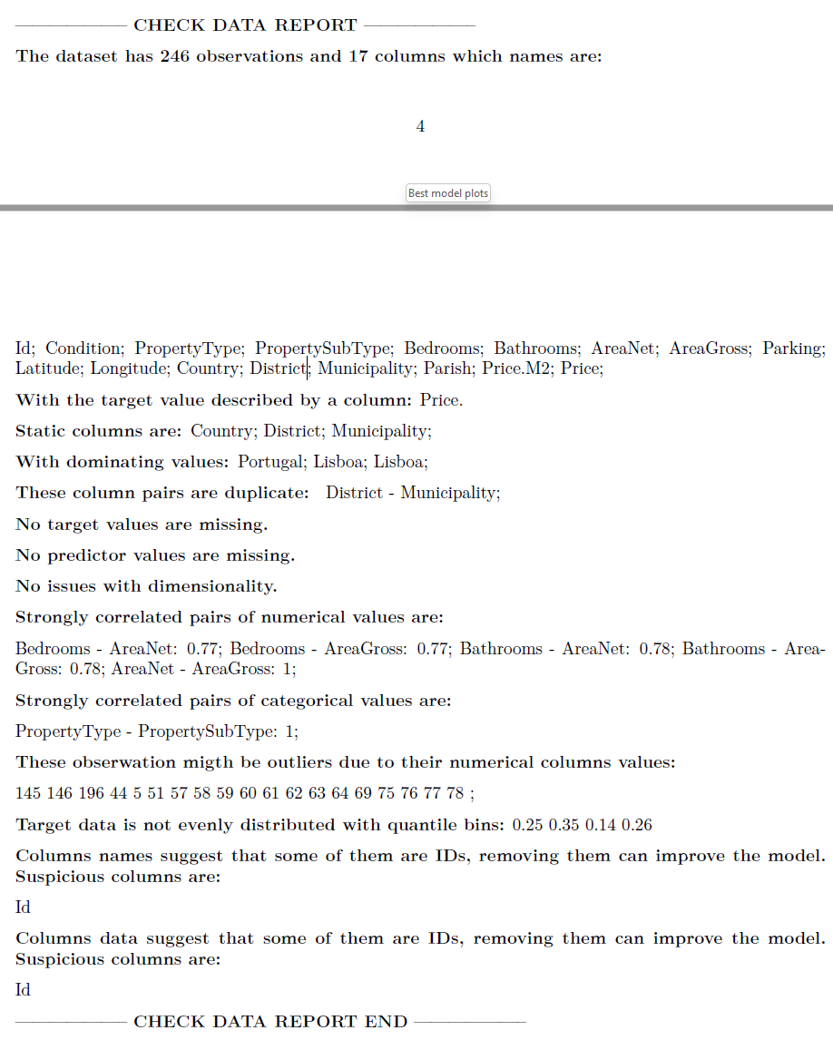
Data Check
Provides basic information about the dataset.
Informs about possible issues, like correlations, static columns, missing values, etc.
On the 16th of November, we conducted a forester ’hands-on’ workshop on ML expert group from MI2.AI. During the vivid discussion, the check data report came as one of the most innovative and demanded functionalities of the package.

Slide 21
07
Market analysis
For whom is it created?
Why is it better than other tools?

Slide 22
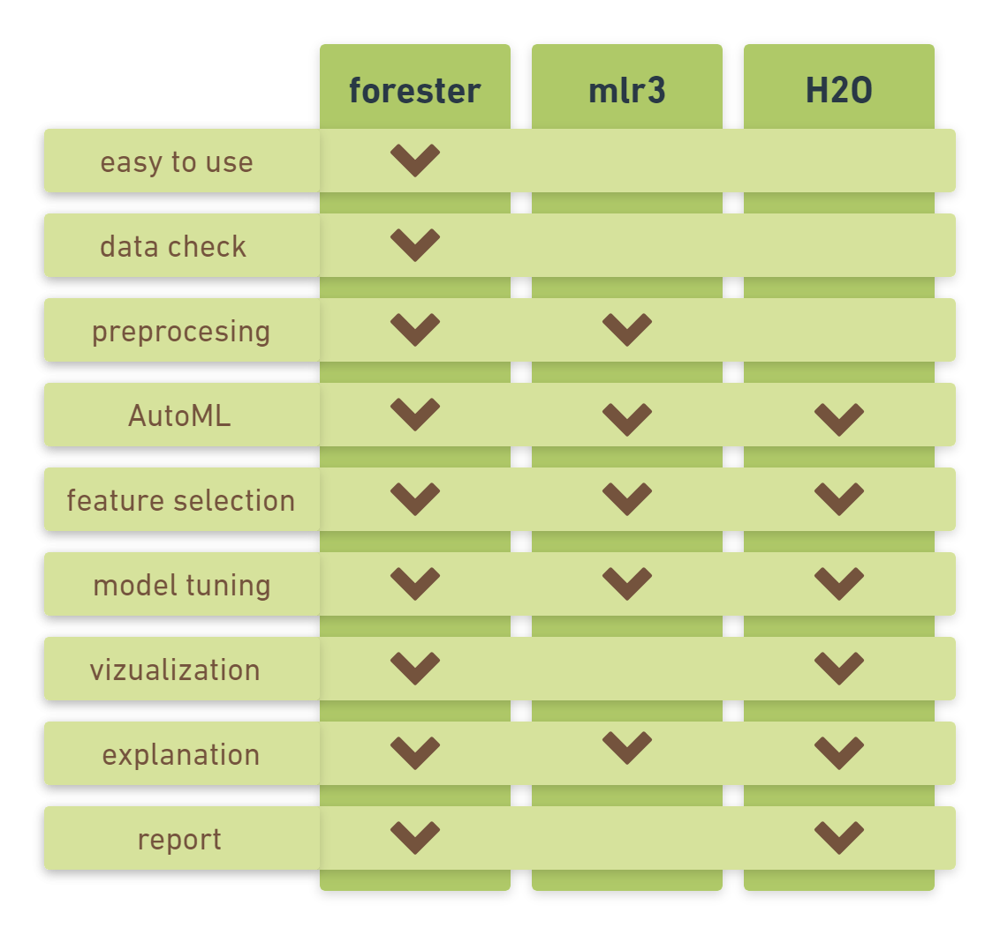
Existing solutions
In comparison to other AutoML frameworks present in R, the forester is the only one that is easy to use. The package differentiates itself in this aspect from powerful AutoML frameworks like mlr3 and H2O. These tools on the other hand provide a wider variety of ML models.
How to use it?
library(forester)
data(`lisbon`)
train_output <- train(lisbon,`Price`)

Slide 23
For whom is this package created?
Beginners: Excellent tool to create first models and learn how to understand the outcomes.
Researchers: Enables to use AutoML in different science fields without the need to hire the team of data scientists
Experts: They get an easy-to-use tool that can be used to prepare high-quality baseline models or a set of output parameters for more thorough optimizations.

Slide 24
Thank you for your attention!

Slide 25
Future work
02.2023
Implementation of multi-label classification.
05.2023
Module with automated exploratory data analysis (AutoEDA).
06.2023
Paper publication: introducing the forester package to the broader community.
09.2023
Creation of more advanced and user-defined reports.
07-09.2023
Package use to conduct research identifying the needs of different user types.
04.2023
RML blog posts about forester.

